Slide 1

LSAC 2018 hackaton
Lessons Learned

Slide 2
Day 1
We started as a group working on two problems
Zoom in on the job vacancy problem
Use the SURF recipe to describe the problem and make a service

Slide 3
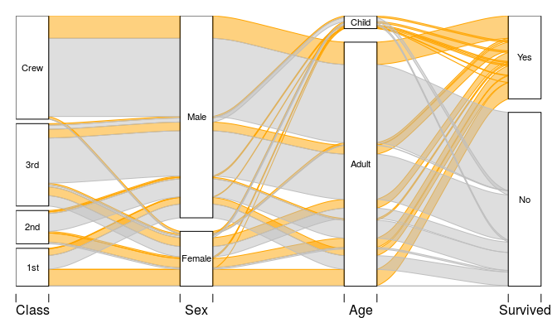
Details of the Job Vacancy Problem
Starting with a job vacancy database (10.000+ records) we would like to present students a study path that they can take to acquire all the skills they need to qualify for their dream job.
We translated this to the following:
Question: what is your dream job?
Visualisation: The most likely path to take, based on the students (highschool) profile
Highschool profile
Bachelor
MASTER
Job

Slide 4
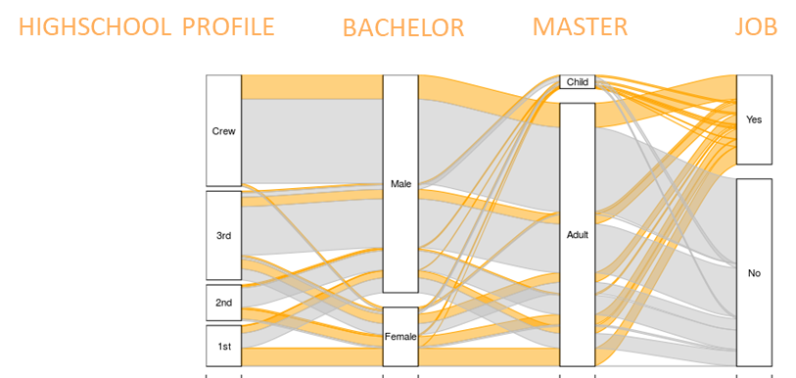
Recipe - phase 1
What’s is your dream job?
data
algorithm

Slide 5
The data sources and algorithms
We came up with four datasources that might be involved
Job vacancy database (describing jobs and skills)
Registry data (describing the relation between people’s education and current job)
ESCO taxonomy of skills and jobs (to identify jobs/skills)
Higher Education history of graduated students (to match the current student against the group of all graduated students)
It turned out that we could create the intended visualiation with just two databases and later refine the outcome
Step 1: use registry data and graduated students data, to show most likely path
Step 2: refine step 1 with esco and job vacancy data to make it more precise and current.

Slide 6
Recipe - phase 2
What’s is your dream job?
data
Student profile
algorithm
Register data
Step 1: Search for 3 most probable jobs, based on profile
Graduated student data
Calculate different routes
Job vacancy
Esco taxonomy
Step2: refine routes / map jobs on available jobs

Slide 7
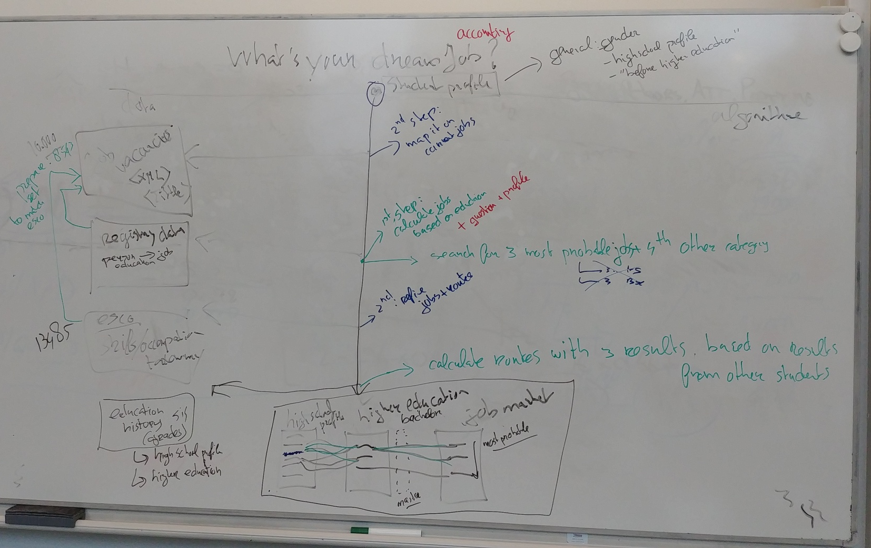
On the whiteboard, it looked like this ☺

Slide 8
Lesson learned on the recipe
The recipe turned out to be a good tool to discuss the problem, without going to much into the details
The data sources need some preprocessing
We liked using esco to pinpoint jobs and skills in other databases
It turned out that we do not have to use our original databases to answer the question. So, think about databases after you decide on the question/visualisation

Slide 9
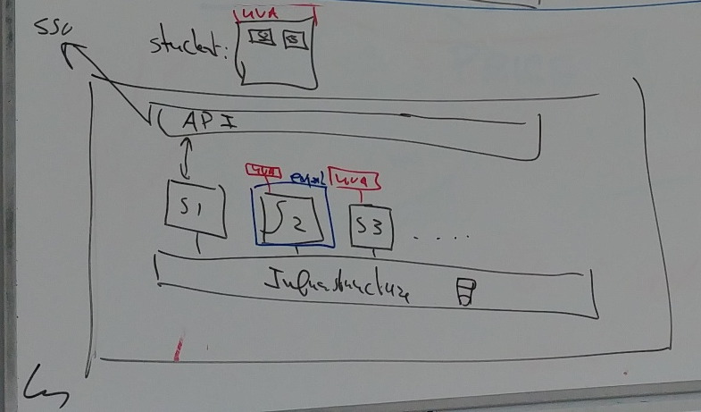
Moving on to the 2nd problem
Reuse the job vacancy problem as a service in the new SURF infrastructure
Suppose we have a set of services s1, s2, s3 and so on, s2 being the job vacancy service
Then we run this on a general infrastructure, for storage, and should be able to access the service through an API, with single sign on (SSO)
In this example you see also a students dashboard from a student from UvA. Where UvA connected the datasources for s2 and s3, so the student can use these LA services!
The blue border indicates the boundaries of the job vacancy problem. This is the domain of the expert/researcher on this area.

Slide 10
The boundaries
To make the service work it should be a self contained proces with some entry points to start actions
These migth be some points to consider: prepareData, verifyData, runAlgorithm, verifyAlgorithm, getVisual

Slide 11
Lessons learned on the service
Where do service and wrapper meet
The wrapper provides login atributes, so the service knows: Who is the student, name, email, etc.
The wrapper takes care of student consent, when datasources are connected this consent is given by the institution
Detailed student information should be a datasource, Think about: highschool profile, current curriculum
The service needs to be able to store state.

Slide 12
Day 2
Work on the interface
Work on the service

Slide 13
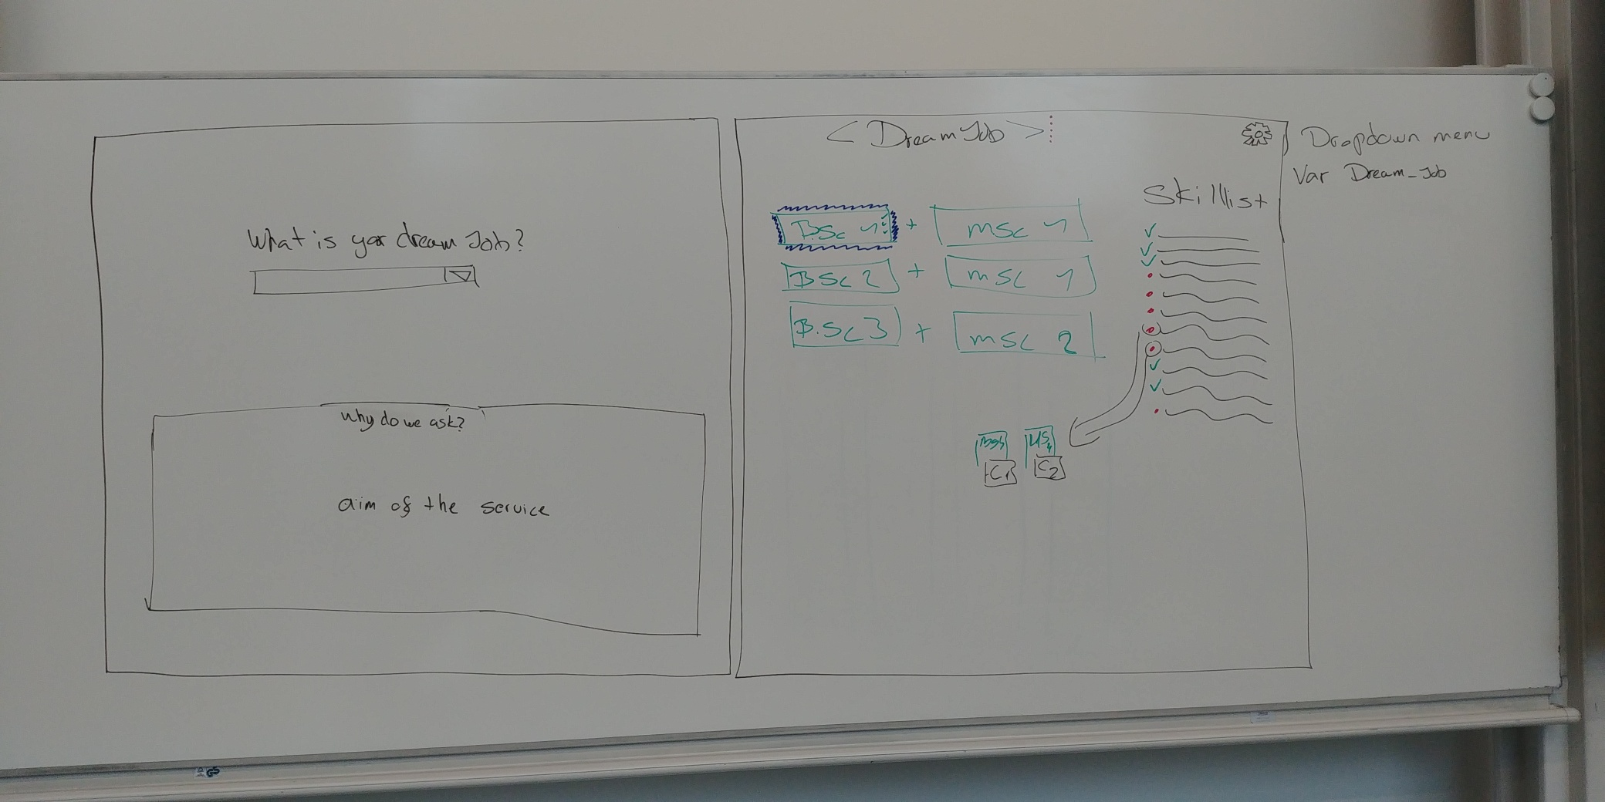
A new interface
After a good night sleep, it was decided that the visualisation should be different
Just a graph would not do the trick
Work was done on a new interface where more focus was given to:
the skillist that is needed to qualify for a job
help the student with building blocks to acquire the skills.

Slide 14
Lesson learned on the recipe (2)
On day 1 we started with the job vacancy database, that was not a good starting point
It’s beter to start with the visualization / the interface that is needed to report to the student
With a good description of the interface it will be possible to determine what data and algorithms should be used to get to that interface
Thinking about a problem, described by a question and an interface, takes a lot of time (just as all use cases in a software develpment proces do)

Slide 15
About the service
We split working on a service in two seperate tasks
Working on an repository of open algorithms/services
Working on an open architecture
We like to fullfill the following process
s1
API
Service of an expert
(example: job vacancy)
s2
s1
s2
s3
s3
ìnfrastructure
Repository of open algorithms
Reuse in an open Architecture

Slide 16
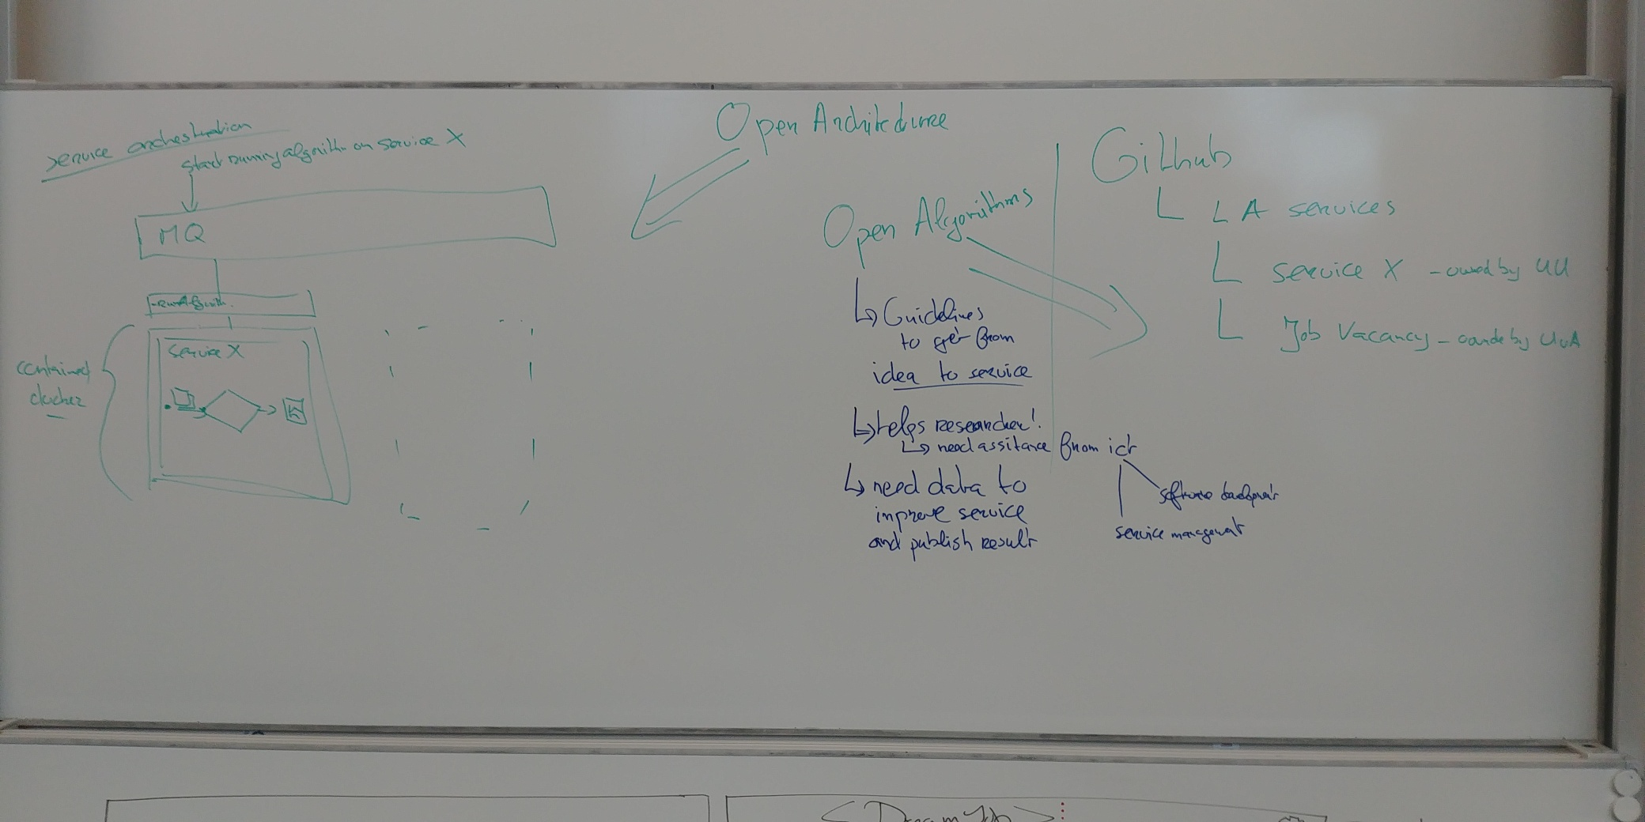
Lessons learned on an open architecture
The open architecture should be about service orchestration
Services should be self contained and can be used standalone or within the bigger picture
A Message Queue could be used to pass higher level questions to the right service
‘start running algorithm on service 1’
‘prepare data on service 2’
We started implementing a couple of docker containers with rabbitmq (MQ), nodered (API/FLOW) and a simple service to demonstrate this.

Slide 17
Lessons learned on open algorithms
Researchers are the expert on the problem but need help to make it available as a service
A couple of ideas
Write quidelines to get from idea/research to service
Help researcher with ICT: software development and/or service management
Collect data from actual use of service to improve service and publish results
It might be a good idea to use github as a repository of LA services
Each individual LA service should be owned by a member of an institution

Slide 18
Herman.vandompseler@surfnet.nl
Thank you
Notes:
De tekst zonder aanhalingstekens en zonder vraagteken. We willen hier graag ook nog de lijn plaatsen aan de rechterkant, maar dan in het wit.

